Slide 1

C
PROGRAMMING FOR PROBLEM SOLVING
Unit 2
Arrays
Course Code: 25EN1114
Course Course Coordinator(s) : Dr. SRIKANTH/TANAYA BALA BEHERA
Course Instructor :
Academic Year: 2025–2026
Year :1st
Semester : II

Slide 2
Applications of One Dimensional Array

Slide 3
Linear Search
What is Linear Search?
Linear search is a method for finding a specific element (target) in a list or array by checking each element one by one, from start to end, until the target is found or the list ends.

Slide 4
Linear Search
Linear Search Algorithm
Start
Input: An array arr[] of size n and the target value x.
Loop through the array from index i = 0 to n-1:
If arr[i] == x:
Return the index i (element found).
If the loop ends without finding the element:
Return -1 (element not found).
End

Slide 5
Linear Search
Problem
arr[] = {4, 7, 1, 9, 3} search for the number 9.
Start from the first element: Compare 4 with 9 → Not a match.
Move to the next element: Compare 7 with 9 → Not a match.
Move to the next: Compare 1 with 9 → Not a match.
Move to the next: Compare 9 with 9 → Match found!
Return the index → Index = 3

Slide 6
Linear Search
#include <stdio.h>
int linearSearch(int arr[], int size, int target) {
for (int i = 0; i < size; i++) {
if (arr[i] == target) {
return i; // Return the index if the element is found
}
}
return -1; // Return -1 if not found
}
int main() {
int arr[] = {4, 7, 1, 9, 3};
int size = sizeof(arr) / sizeof(arr[0]);
int target = 9;
int result = linearSearch(arr, size, target);
if (result != -1) {
printf("Element %d found at index %d\n", target, result);
} else {
printf("Element %d not found\n", target);
}
return 0;
}

Slide 7
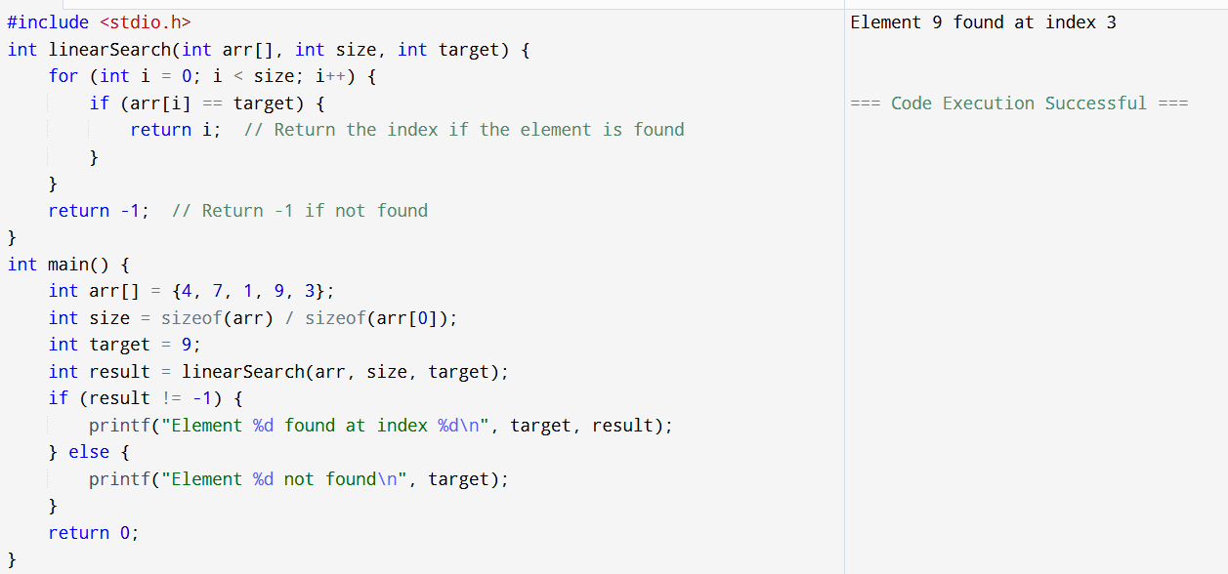
Linear Search

Slide 8
Linear Search
Linear Search checks each element one-by-one.
If it finds a match → it stops immediately.
If no match is found → it scans the entire array and returns "Not found.“
Works on unsorted data too, which makes it versatile but slower for large datasets.

Slide 9
Linear Search
Scenario 1: Finding a Book in a Shelf
Imagine a long bookshelf where books are arranged randomly.
You’re searching for a book titled "Harry Potter.“
You start from the first book and check each one one by one until you find it.
This is Linear Search!

Slide 10
Linear Search
Scenario 2: Searching for Your Friend in a Crowd
You’re at a school event with a huge crowd.
You look at each face individually until you spot your friend.
This is Linear Search — checking each "element" (person) until you find the target!

Slide 11
Binary Search
What is Binary Search?
Binary Search is an efficient searching algorithm that finds a target value within a sorted array by repeatedly dividing the search space in half.

Slide 12
Binary Search Algorithm
Works only on sorted arrays or lists
At each step, find the middle element of the current range
Compare the target with the middle element:
If equal → target found
If smaller → search in the left half
If larger → search in the right half
Each iteration eliminates about half of the search space
Time Complexity: O(log n)
Much faster than Linear Search (O(n)) for large datasets

Slide 13
Binary Search
Binary Search Algorithm
Start
Input:
A sorted array arr[]
A target value x
Initialize:
low = 0
high = n - 1 (where n is the number of elements)
Loop while low ≤ high:
Find the middle index:
mid=low+high/2​
Check:
If arr[mid] == x → ✅ Return mid (Element found!)
If arr[mid] > x → Search left half: Set high = mid – 1
If arr[mid] < x →Search right half: Set low = mid + 1
If not found:❌ Return -1
End

Slide 14
Binary Search
Problem
Array: {2, 4, 6, 8, 10, 12, 14}
Target: 10
Step 1: low = 0, high = 6, mid = 3 → arr[3] = 8
Step 2: Search right half (low = 4)
Step 3: New mid = 5, arr[5] = 12
Step 4: Search left half (high = 4)
Step 5: mid = 4, arr[4] = 10 Found!

Slide 15
Binary Search
#include <stdio.h>
int binarySearch(int arr[], int low, int high, int target) {
while (low <= high) {
int mid = (low + high) / 2;
// Check if target is found
if (arr[mid] == target) {
return mid;
}
// If target is larger, search the right half
if (arr[mid] < target) {
low = mid + 1;
}
// If target is smaller, search the left half
else {
high = mid - 1;
}
}

Slide 16
Binary Search
// If target is not found
return -1;
}
int main() {
int arr[] = {2, 4, 6, 8, 10, 12, 14};
int size = sizeof(arr) / sizeof(arr[0]);
int target = 10;
int result = binarySearch(arr, 0, size - 1, target);
if (result != -1) {
printf("Element %d found at index %d\n", target, result);
} else {
printf("Element %d not found\n", target);
}
return 0;
}

Slide 17
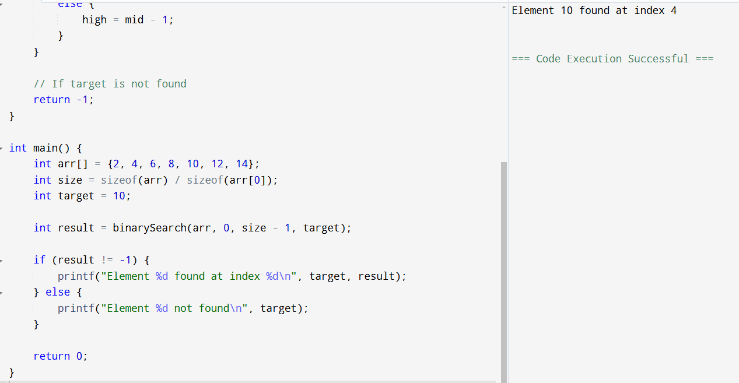
Binary Search

Slide 18
Binary Search
Scenario 1: Finding a Word in a Dictionary
You’re looking for the word "Tiger" in a dictionary.
You open the book in the middle — you land on "Mango.“
Since "Tiger" comes after "Mango," you ignore the first half and focus on the second half.
You repeat the process, halving the remaining pages until you find "Tiger.“
This is Binary Search — repeatedly halving a sorted list!

Slide 19
Binary Search
Scenario 2: Finding a Specific Chapter in a Textbook
You’re looking for Chapter 12 in a textbook with 30 chapters.
You open to Chapter 15 — it’s too far.
You jump back to Chapter 7 — still too early.
You narrow down between 7 and 15 until you land on 12.
Binary Search — divide, compare, repeat!

Slide 20
Bubble Sort
What is Bubble Sort?
Bubble Sort is a simple sorting algorithm that repeatedly compares adjacent elements and swaps them if they’re in the wrong order. It "bubbles" the largest (or smallest) elements to the end of the array, step by step.

Slide 21
Bubble Sort
Bubble Sort Algorithm
Start: Take an array of size n.
Outer loop: Repeat the process for n-1 passes (because the last element gets sorted automatically).
Inner loop: Compare adjacent elements:If arr[j] > arr[j+1] → Swap the two elements.
Optimization (optional):If no swaps happen in a complete pass, the array is already sorted — break early.
End: The array is sorted!

Slide 22
Bubble Sort
Problem
Array: {4, 2, 7, 1}
Pass 1:
Compare and swap adjacent elements:
Compare 4 and 2 → Swap → {2, 4, 7, 1}
Compare 4 and 7 → No swap
Compare 7 and 1 → Swap → {2, 4, 1, 7}
Largest number (7) is now in the right place!

Slide 23
Bubble Sort
Pass 2:
Compare 2 and 4 → No swap
Compare 4 and 1 → Swap → {2, 1, 4, 7}
Largest number (7) is now in the right place!
Pass 3:
Compare 2 and 1 → Swap → {1, 2, 4, 7} Sorted!
Final Answer
Sorted Array: {1, 2, 4, 7}

Slide 24
Bubble Sort
#include <stdio.h>
int main() {
int arr[] = {4, 2, 7, 1};
int n = 4; // Number of elements
int temp;
// Bubble sort logic
for (int i = 0; i < n - 1; i++) {
for (int j = 0; j < n - i - 1; j++) {
if (arr[j] > arr[j + 1]) {
// Swap elements
temp = arr[j];
arr[j] = arr[j + 1];
arr[j + 1] = temp;
}
}
}
// Print the sorted array
printf("Sorted Array: ");
for (int i = 0; i < n; i++) {
printf("%d ", arr[i]);
}
return 0;
}

Slide 25
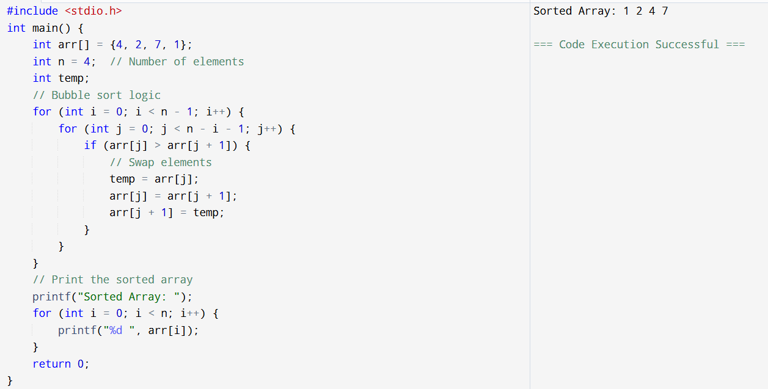
Bubble Sort

Slide 26
Bubble Sort
Scenario 1: Sorting Students by Height
Imagine a group of students standing in a random order.
You compare two students at a time — if the taller one is on the left, you swap them.
You repeat this for the whole line, then start again from the beginning until no more swaps are needed.
This is Bubble Sort — "bubbling" the tallest (or smallest) to the correct position!

Slide 27
Bubble Sort
Scenario 2: Ranking Scores in a Game
You and your friends played a video game, and you want to sort the scores from lowest to highest.
You compare two scores — if the higher one is before the lower one, swap them.
Keep doing this until all scores are sorted.
Bubble Sort — scores "bubble" into the right order!

Slide 28
Selection Sort
What is Selection Sort?
Selection Sort is a sorting algorithm that works by repeatedly finding the smallest (or largest) element from the unsorted part of the array and moving it to its correct position.

Slide 29
Selection Sort
Selection Sort Algorithm
Start: Take an array of size n.
Outer loop: Repeat the process for n-1 passes (because the last element gets sorted automatically).
Inner loop: Find the smallest element from the unsorted part of the array and swap it with the first unsorted element.
Step 1: Find the smallest element and swap it with the first position.
Step 2: Move to the next position and repeat the process for the remaining unsorted elements.
Step 3: Keep selecting the smallest element from the remaining unsorted part and placing it in the correct position until only one element remains unsorted.
End: The array is now completely sorted!

Slide 30
Selection Sort
Problem
Array: {29, 10, 14, 37, 13}
Pass 1:
Find the smallest number (10).
Swap it with 29.
New array: {10, 29, 14, 37, 13}
Pass 2:
Find the smallest number in the remaining part (13).
Swap it with 29.
New array: {10, 13, 14, 37, 29}

Slide 31
Selection Sort
Pass 3:
Find the smallest number (14) — it’s already in place!
No swap needed.
Pass 4:
Find the smallest number (29).
Swap with 37.
New array: {10, 13, 14, 29, 37}
Final Answer
Sorted Array: {10, 13, 14, 29, 37}

Slide 32
Selection Sort
#include <stdio.h>
int main() {
int arr[] = {29, 10, 14, 37, 13};
int n = 5; // Number of elements
int i, j, minIndex, temp;
// Selection Sort logic
for (i = 0; i < n - 1; i++) {
minIndex = i; // Assume current element is the smallest
// Find the index of the smallest element in the remaining array
for (j = i + 1; j < n; j++) {
if (arr[j] < arr[minIndex]) {
minIndex = j;
}
}
// Swap the smallest element with the current element
temp = arr[i];
arr[i] = arr[minIndex];
arr[minIndex] = temp;
}

Slide 33
Selection Sort
// Print the sorted array
printf("Sorted Array: ");
for (i = 0; i < n; i++) {
printf("%d ", arr[i]);
}
return 0;
}

Slide 34
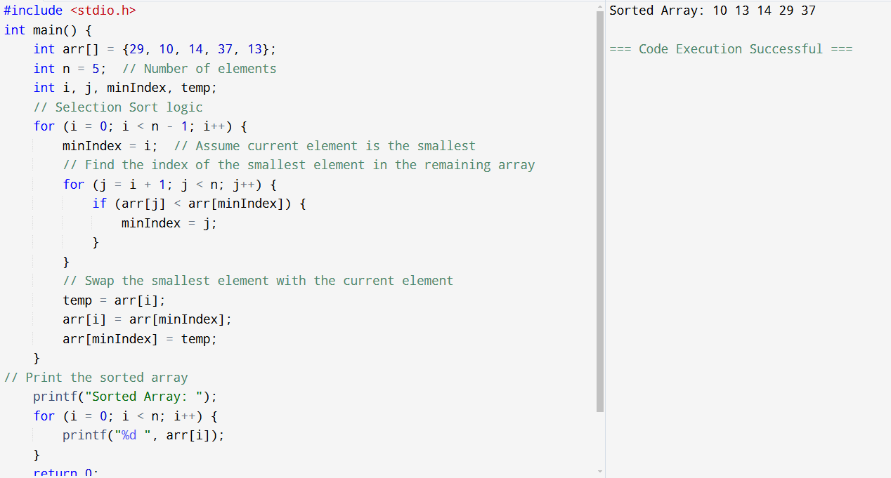
Selection Sort

Slide 35
Selection Sort
Scenario 1: Picking Teams for a Game
You’re picking players for a team, but you want to start with the fastest player.
You scan the whole group to find the fastest one and move them to the first position.
Then, you repeat the process with the remaining players, picking the next fastest each time.
This is Selection Sort — repeatedly selecting the smallest (or largest) item and moving it to the correct spot!

Slide 36
Selection Sort
Scenario 2: Ranking Students by Marks
A teacher wants to rank students from highest to lowest marks.
They find the student with the highest score and put them first.
Then they repeat with the remaining students until everyone is ranked.
Selection Sort — repeatedly picking the highest (or smallest) value!

Slide 37
Bubble Sort 🫧 vs Selection Sort 🎯
Feature | Bubble Sort | Selection Sort
How it works | Repeatedly compares adjacent elements | Finds the minimum element in unsorted part
Swapping | Swaps happen many times per pass | Only one swap per pass (after finding min)
Key behavior | Largest element bubbles to end after each pass | Smallest element placed at beginning after each pass
Optimization | Can stop early if no swaps → Best case O(n) | Always scans full unsorted → No best-case optimization
Efficiency | Inefficient for large arrays (many swaps) | Fewer swaps, but still O(n²) comparisons
Use case | Works well if array is almost sorted | Works consistently, no early stop
Example | Sorting → keeps swapping neighbors | Sorting → picks 3, swaps with 5
.

Slide 38
Algorithm | Swap Strategy | Swap Count (for [8,6,5,3])
Bubble Sort 🫧 | Swaps any adjacent pair that's out of order. | High (6 swaps)
Selection Sort 🔎 | Finds the minimum, then performs one swap per pass. | Low (2 swaps)

Slide 39
Applications of Two Dimensional Array

Slide 40
2D array
Scenario 1: Cinema Seating Arrangement 🎬
A movie theater has rows and columns of seats.
Each seat can be booked (1) or available (0).
Row 1, Seat 2 is available, while Row 1, Seat 1 is booked!
cinema[5][10] = { {1, 0, 1, 1}, {0, 0, 1, 0}, ... };

Slide 41
2D array
Scenario 2: Board Game (Sudoku) 🎲
Sudoku has a 9x9 grid where each cell holds a number from 1 to 9.
Cells with 0 are empty and need to be filled.
sudoku[9][9] = { {5, 3, 0, 0, 7, 0, 0, 0, 0}, ... };

Slide 42
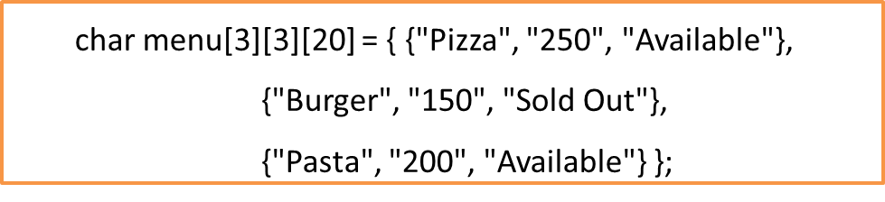
2D array
Scenario 3: Food Menu Tracker 🍔
A restaurant tracks 3 items with their price and stock availability.
Row 1 = Pizza details
Row 2 = Burger details
Row 3 = Pasta details
Check prices or availability by accessing rows and columns!

Slide 43
2D array
Scenario 4: Weekly Timetable 📅
A student tracks their 5-day schedule with 6 periods per day.
Rows = Days, Columns = Periods
Easily check subjects for any day/period!
char timetable[5][6][20] = {
{"Math", "English", "Science", "Break", "History", "PE"},
{"English", "Science", "Math", "Break", "Art", "Computer"},
{"Science", "History", "English", "Break", "Math", "Music"},
{"Math", "PE", "History", "Break", "Science", "Art"},
{"Computer", "Music", "Math", "Break", "English", "PE"}
};

Slide 44


Matrix Operations-Addition Using Two Dimensional Array
Matrix addition is performed by adding corresponding elements of two matrices.
Formula:
Sum Is:

Slide 45
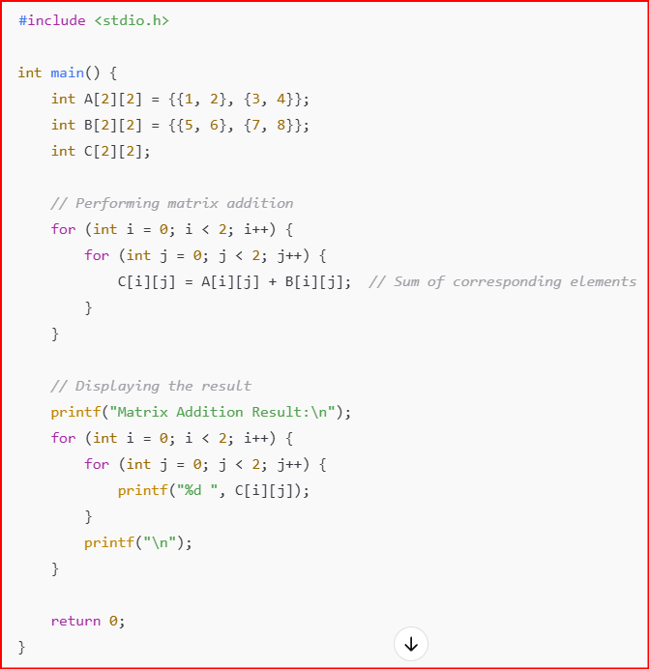
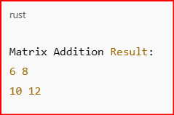
Implementation of Matrix Operations-Addition
Output

Slide 46

Matrix Operations-Subtraction Using Two Dimensional Array
Matrix subtraction follows the same rule as addition but subtracts corresponding elements.
Same logic as addition.
Formula:

Slide 47
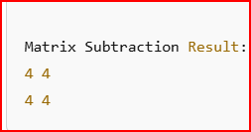
#include <stdio.h>
int main() {
int A[2][2] = {{9, 8}, {7, 6}};
int B[2][2] = {{5, 4}, {3, 2}};
int C[2][2];
// Performing matrix subtraction
for (int i = 0; i < 2; i++) {
for (int j = 0; j < 2; j++) {
C[i][j] = A[i][j] - B[i][j]; // Subtract corresponding elements
}
}
// Displaying the result
printf("Matrix Subtraction Result:\n");
for (int i = 0; i < 2; i++) {
for (int j = 0; j < 2; j++) {
printf("%d ", C[i][j]);
}
printf("\n");
}
return 0;
}
Implementation of Matrix Operations-Substraction
Output

Slide 48


Matrix Operations-Multiplication Using Two Dimensional Array
Matrix multiplication follows a specific rule: the number of columns in the first matrix must be equal to the number of rows in the second matrix.
Formula:
The product C = A × B :

Slide 49
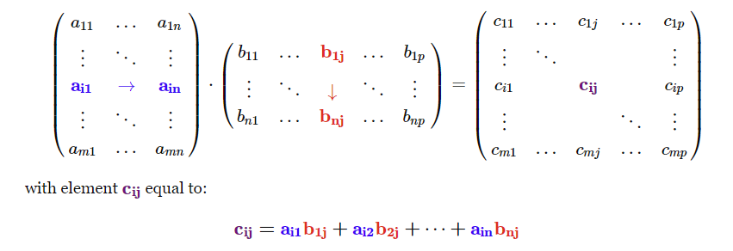
Matrix Operations-Multiplication Using Two Dimensional Array

Slide 50
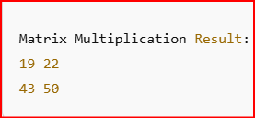
#include <stdio.h>
int main() {
int A[2][2] = {{1, 2}, {3, 4}};
int B[2][2] = {{5, 6}, {7, 8}};
int C[2][2];
// Performing matrix multiplication
for (int i = 0; i < 2; i++) {
for (int j = 0; j < 2; j++) {
C[i][j] = 0; // Initialize sum to zero
for (int k = 0; k < 2; k++) {
C[i][j] += A[i][k] * B[k][j]; // Multiply and sum
}
}
}
// Displaying the result
printf("Matrix Multiplication Result:\n");
for (int i = 0; i < 2; i++) {
for (int j = 0; j < 2; j++) {
printf("%d ", C[i][j]);
}
printf("\n");
}
return 0;
}
Implementation of Matrix Operations-Multiplication
Output

Slide 51
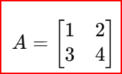
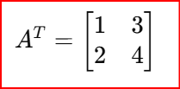
Matrix Transpose Using Two Dimensional Array
In linear algebra, the transpose of a matrix is an operator which flips a matrix over its diagonal; that is, it switches the row and column indices of the matrix A by producing another matrix.
To state formally, the i-th row, j-th column element of the transpose matrix A^{T} is the j-th row, i-th column element of A:
Formula:
The transpose is:

Slide 52
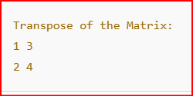
#include <stdio.h>
int main() {
int A[2][2] = {{1, 2}, {3, 4}};
int T[2][2];
// Computing the transpose of the matrix
for (int i = 0; i < 2; i++) {
for (int j = 0; j < 2; j++) {
T[j][i] = A[i][j]; // Swapping row and column elements
}
}
// Displaying the transpose matrix
printf("Transpose of the Matrix:\n");
for (int i = 0; i < 2; i++) {
for (int j = 0; j < 2; j++) {
printf("%d ", T[i][j]);
}
printf("\n");
}
return 0;
}
Implementation of Matrix Transpose:
Output

Slide 53
THANK YOU

